Slide 1
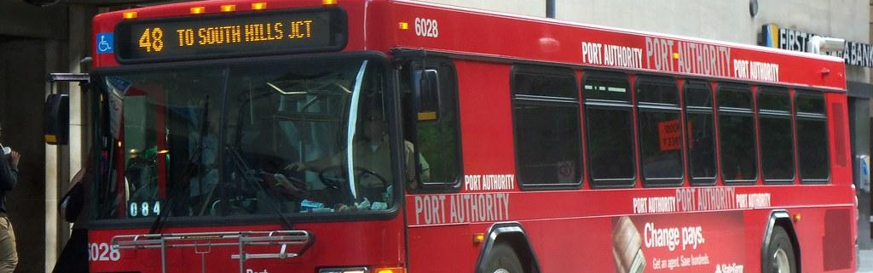
Behind Schedule: An Investigation into Pittsburgh Regional Transit Performance
67-364: Project 1
Noelani Phillips 1 | Luke Nalewajk

Slide 2
Agenda
3
Key Findings
4
Introduction and Motivation
5
Dataset
6
Analysis
17
Discussion of Results

Slide 3
Key Findings
Pg 3
67-364: Project 1
Port Authority has not met its On-Time Performance goal of 73% for bus service in 2024, and bus service has not significantly improved since the beginning of data collection in 2017, despite rebranding and restructuring initiatives.
CMU bus routes lag far behind in OTP compared to other bus routes around the city being below the average bus in 2024 and the target OTP. The Collier garage buses perform at the target OTP of 73%.
PRT’s Sunday service sees the best overall performance in 2024 and holistically compared to Saturday and Weekday service, but still falls short of the OTP target.

Slide 4
Introduction and Motivation
Pg 4
67-364: Project 1
Pittsburgh Regional Transit (PRT), formerly Port Authority, provides Bus and Rail Transportation for the Greater Pittsburgh Community. Many Pittsburgh residents and university students rely on PRT for commuting.
PRT sets monthly average On-Time Performance (OTP) goals of 73% for Buses and 80% for Rail, defining "on time" as within one minute early or five minutes late.
This report quantifies PRT’s reliability and evaluates if it meets these OTP goals, particularly for routes popular with university students. The findings aim to inform students and the broader community while holding PRT accountable.

Slide 5
Dataset
Pg 5
67-364: Project 1
PRT Monthly On Time Performance by Route
Jan 2017-September 2024
On-Time Performance Data with info on transportation mode (Bus, Rail), route, garage, date, and service day
Sourced from the Western Pennsylvania Regional Data Center
Port Authority Monthly On Time Performance by Route - Dataset - CKAN

Slide 6
Research Questions
Pg 6
67-364: Project 1
Question 1: Has PRT met its OTP targets this year, and have they improved over time (since 2017 when the data collection began)?
Question 2: Do CMU-Centric routes see better OTP? Which routes have the best and worst OTP?
Question 3: Does Bus OTP Performance Differ by Type of Day, and How Does Time of Year Affect this Relationship?

Slide 7
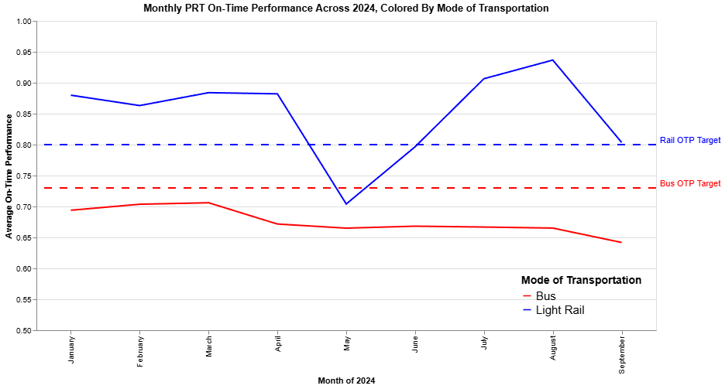
Analysis: Question 1
Pg 7
67-364: Project 1
OTP for Buses consistently below target
Rail OTP consistently above target.
Bus performance declines throughout year.
Notes:
To address our first research question, I first constructed a line chart that compares monthly OTP for all bus and rail service in 2024 to PRT’s OTP Target. On-Time Performance for the rail service hovers at around 15-20% above bus service and consistently exceeds PRT’s target. This supports our theory that the nature of rail service makes it inherently more reliable as it is less susceptible to traffic congestion and delays. Bus performance however, consistently failed to meet the target in 2024, and it declined throughout the year having its peak in march and its lowest performing month in September of 2024. One interesting note is that rail performance saw a significant dip in May, we theorized that the Pittsburgh Marathon in early May may have lead to significantly increased ridership as people commuted into the city that caused delays for the rail.

Slide 8
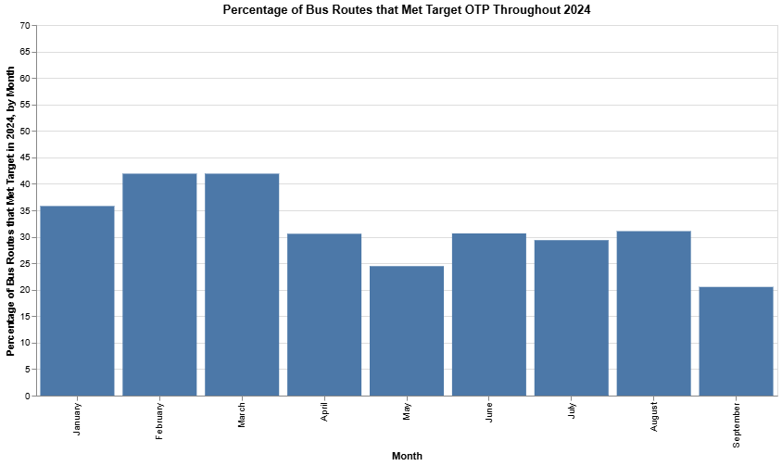
Analysis: Question 1
Pg 8
67-364: Project 1
Consistent <45% Buses meet OTP Target
Performance dips in May and peaks during the summer
Notes:
We identified all bus routes in a given month as meeting the target if their on-time performance was greater than or equal to .73. Examining this bar chart that plots the percentage of bus routes in a month that met such targets throughout 2024, it becomes clear that less than half of all bus routes consistently meet their OTP target throughout the year, and the number of buses meeting their target also seems to decline throughout the year. The lowest performing month is May, which may again have to do with the Pittsburgh marathon as performance seems to recover slightly in the following months. However, the true cause of these fluctuations is unclear.

Slide 9
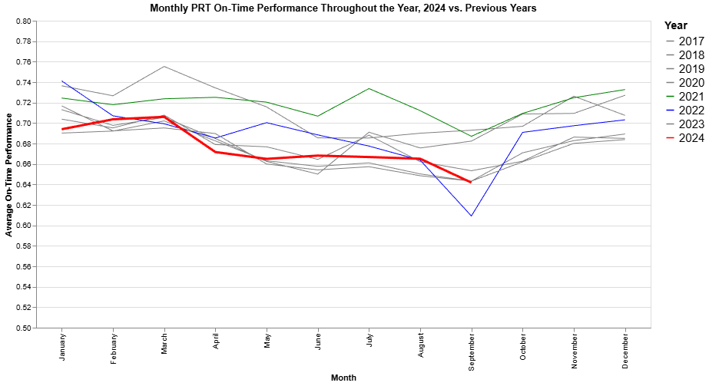
Analysis: Question 1
Pg 9
67-364: Project 1
2024 (red) among lower-performing years
2022 (blue) and 2021 (green) singled out as notably poor and well-performing years
Notes:
Now we look to how PRT’s Buses have performed in 2024 in comparison to previous years on record. 2024, colored in red, is disappointingly among the lower-performing years since 2017, but the trend of performance declining or at least fluctuating throughout the year seems mostly consistent across years. I’ve singled out 2021 in green and 2022 in blue as notably well and poor-performing years respectively. I find it noteworthy that PRT saw its best and worst-performing years in direct succession, but I might attribute this to PRT’s rebrand which I’ll discuss in more depth in the following slide.

Slide 10
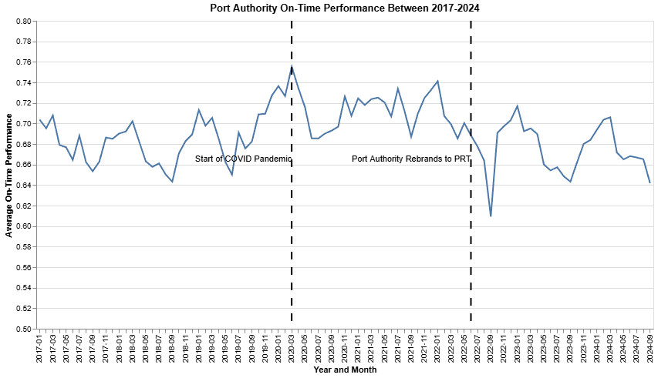
Analysis: Question 1
Pg 10
67-364: Project 1
Notes:
This line chart plots average on-time performance for all bus routes in a given month across the entire time domain of the dataset. I’ve marked notable events for PRT in vertical black lines, one of which being the start of the Covid-19 pandemic in March of 2020, and the other being PRT’s rebrand from Port Authority, which entailed many structural changes. Intuitively, there was a sharp spike in performance following the pandemic, but PRT seemed to recover relatively quickly, and 2021 was its best performing and most stable year. The rebrand and change of ownership in 2022 saw a similar initial dip in performance, but it seems that PRT was never able to really recover and reach its previous highs, and performance has been more volatile since. We theorized that changes in budgets, more resources being allocated to replacing signs and buses and less resources towards drivers could have led to short-staffing and had a negative impact on performance.

Slide 11
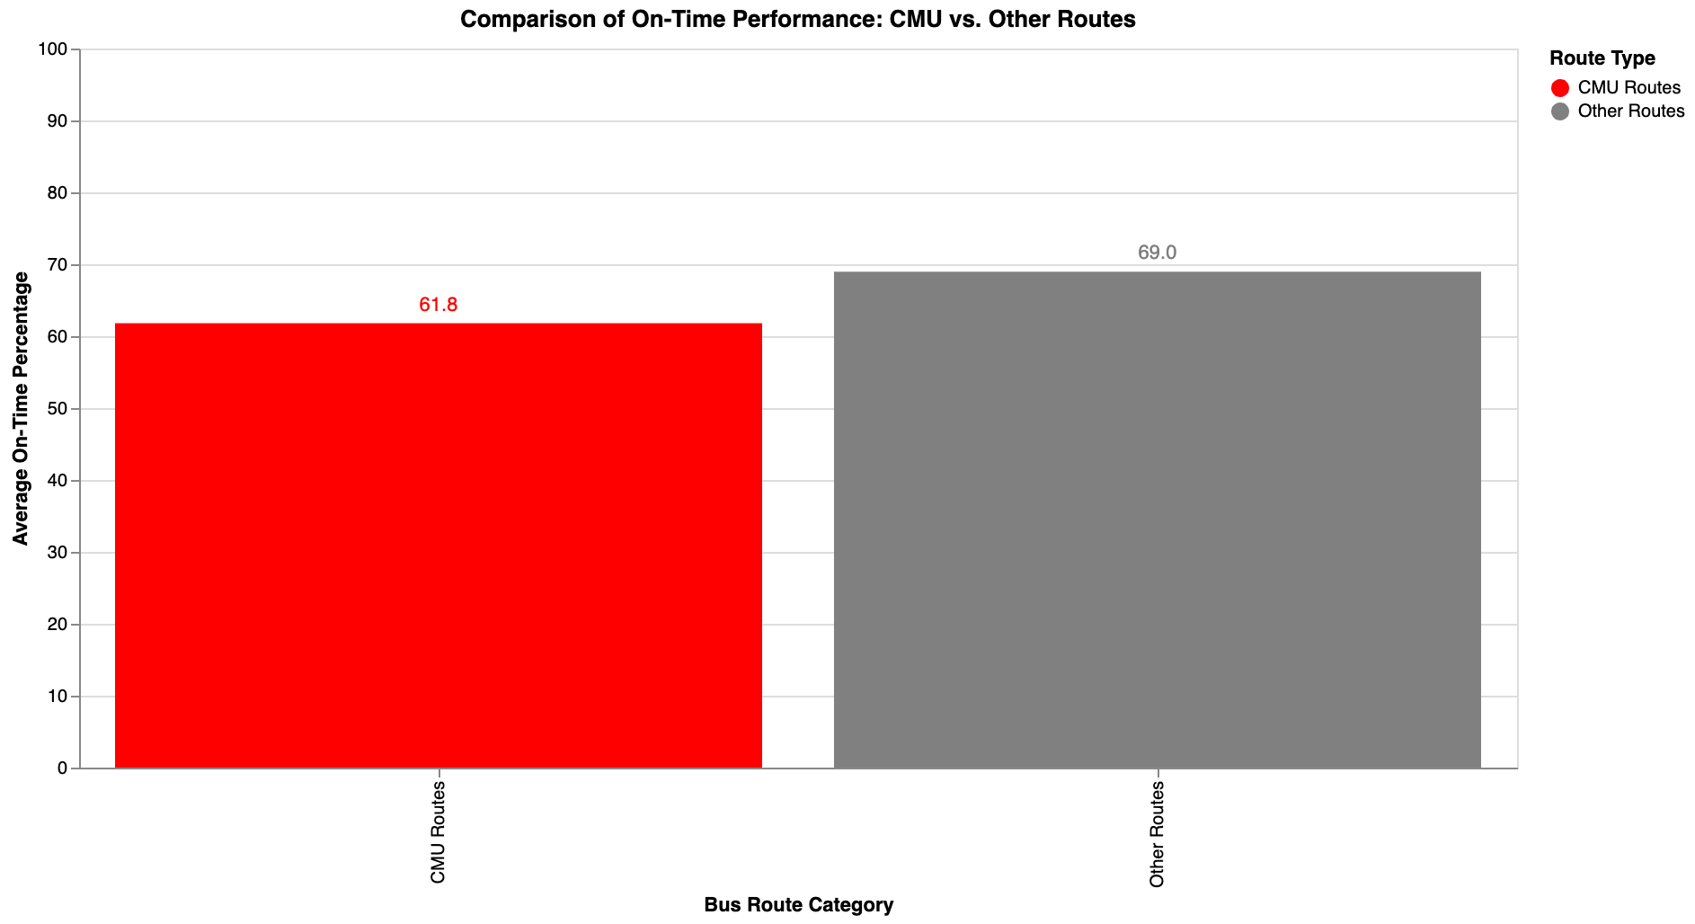
Analysis: Question 2
Pg 11
67-364: Project 1
CMU bus routes perform 7.2% worse than others and 11.2% worse than OTP target

Slide 12
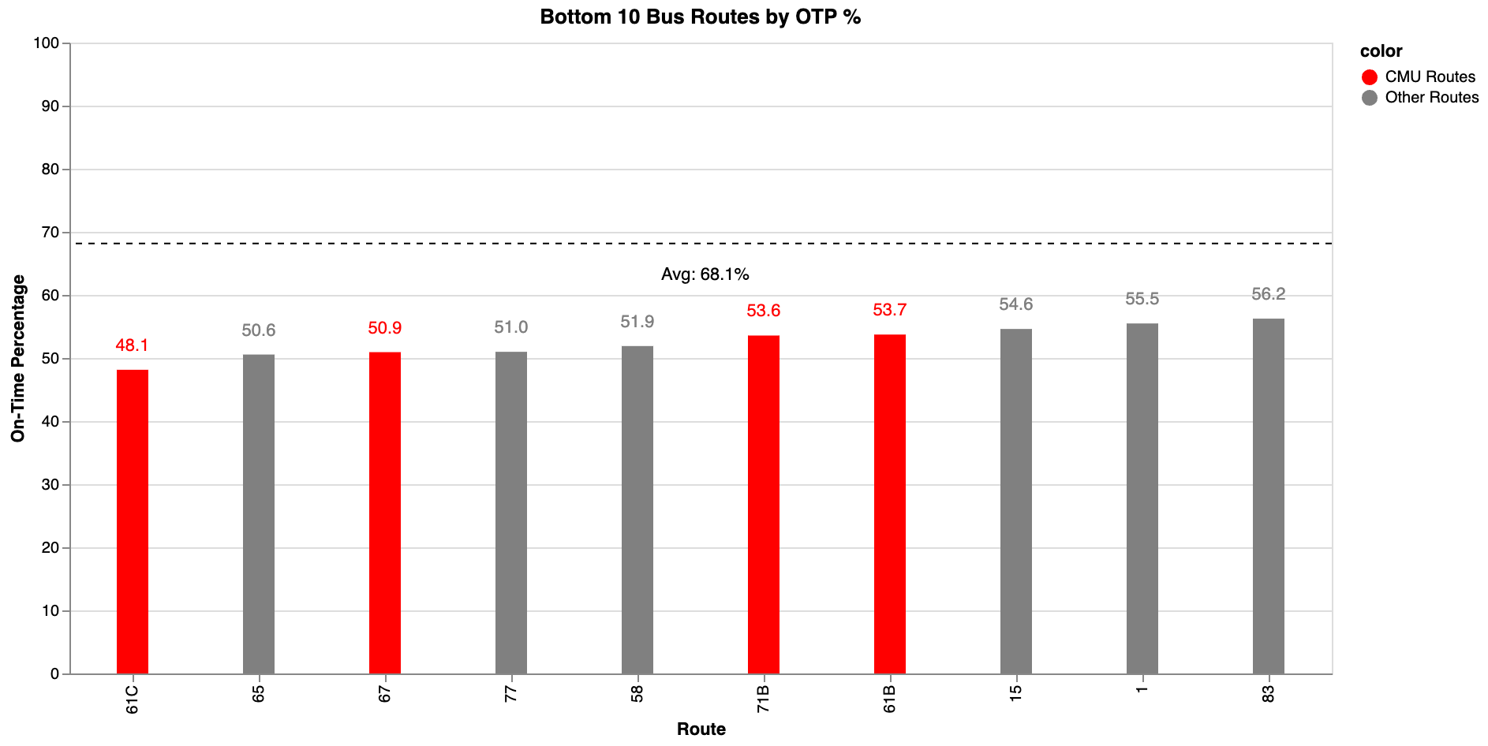
Analysis: Question 2
Pg 12
67-364: Project 1
4 of the bottom 7 belong to the CMU area
All <54% OTP and the 61C <50%
All 15-20% below average OTP

Slide 13
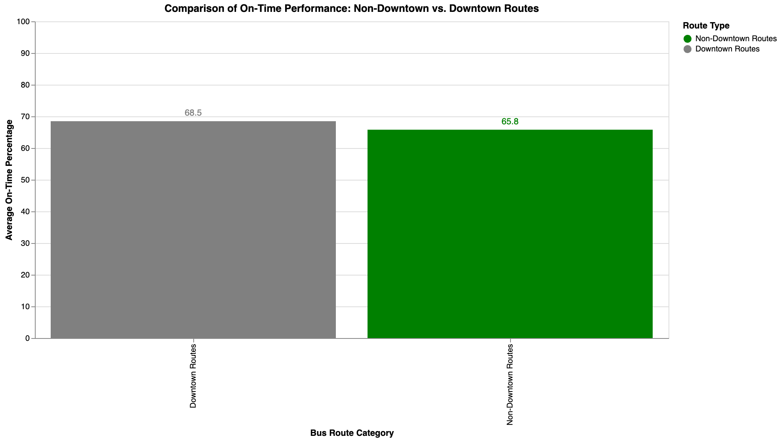
Analysis: Question 2
Pg 13
67-364: Project 1

Slide 14
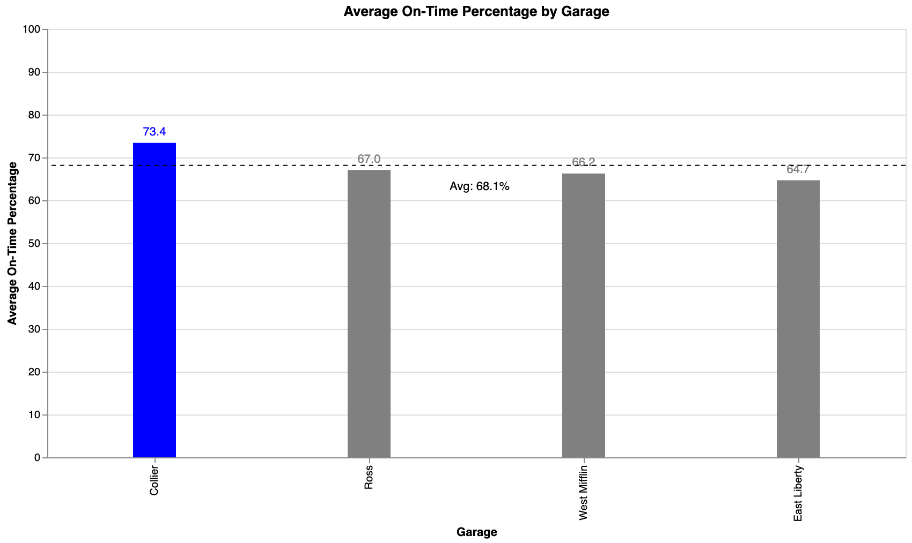
Analysis: Question 2
Pg 14
67-364: Project 1
Collier garage performs at OTP target of 73% and above average PRT bus
East Liberty includes CMU bus routes

Slide 15
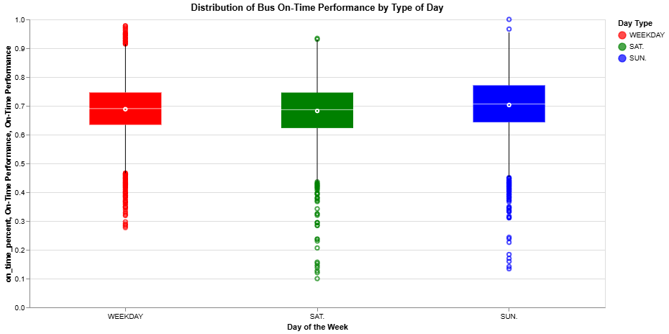
Analysis: Question 3
Pg 15
67-364: Project 1
Noisy performance values across all service days.
Sunday service has slightly higher median OTP
Saturday service has lowest median OTP
Notes:
To address our third research question surrounding how service day may impact on-time performance, we first examined the distributions of on-time performance for each service day across all bus routes, months and years. PRT reductively classifies its service days into three types: Weekday, Saturday, and Sunday service. This limits the depth of the above analysis as it naively assumes that performance between Weekdays is comparable and suitable to be grouped. From the standpoint of the overarching distributions of OTP by service day, there are small but not significant differences in performance. Sunday service has a slightly higher median OTP, and Saturday service has the lowest median OTP, but this visualization is not detailed enough to show any tangible differences.

Slide 16
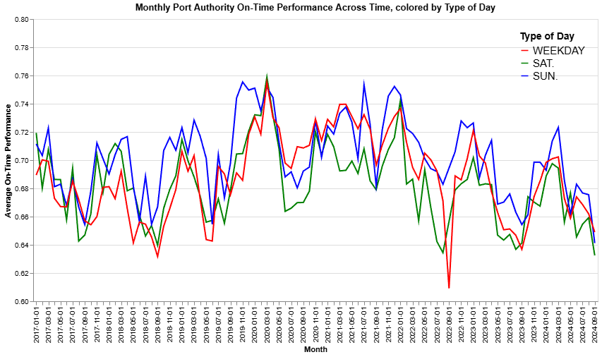
Analysis: Question 3
Pg 16
67-364: Project 1
Notes:
Looking at Average OTP by month for each service day, it’s a bit easier to see the differences in performance. Sunday bus service, colored in blue, generally has higher OTP than the two other service days. This initially seemed counterintuitive, as every student myself included has been disgruntled that they must wait 30 minutes rather than 10-15 for the next scheduled bus on a Sunday. Sunday service operates at a lower frequency, but the analysis has shown that these buses tend to be, on average, on-time more often than buses operating as a part of the Weekday and Saturday services. It is equally plausible that ridership, which this report doesn't explore, has had a large impact on OTP across service days, and ridership on Sunday is likely to be lower than its counterparts. Saturday service, colored in green, looks to be most consistently the worst, which could be because higher ridership is negatively impacting bus arrival times.

Slide 17
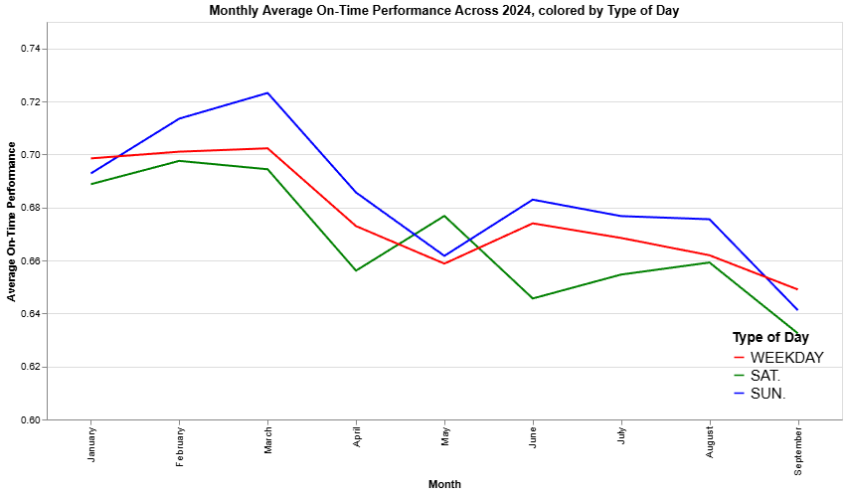
Analysis: Question 3
Pg 17
67-364: Project 1
Performance declines for all groups throughout 2024
Sunday > Weekday > Saturday Service
Notes:
Zeroing-in on performance in 2024, we see the familiar trend of performance declining throughout the year, which was the case for all service days. Sunday performance is once again the highest excluding the month of May and September. In the former month, Sunday and Weekday service saw an uncharacteristic dip in performance while Saturday service saw an uncharacteristic spike. It is unclear what the source of this change may be, although it likely has to do with drastic changes in ridership or events in the Pittsburgh area. Outside of May, Saturday performance is consistently the worst, and Weekday performance hangs in the middle.

Slide 18
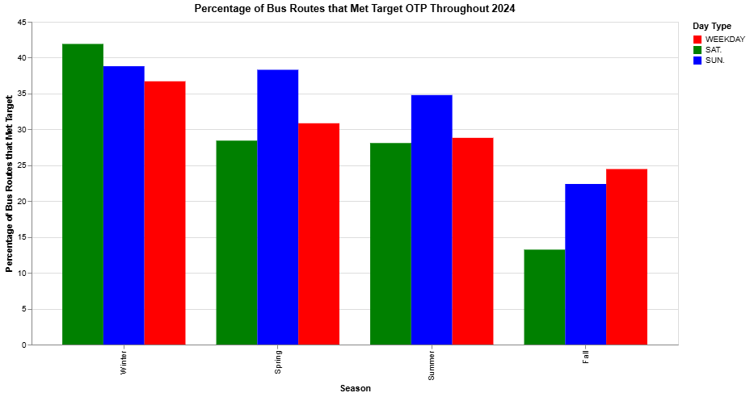
Analysis: Question 3
Pg 18
67-364: Project 1
Saturday Winter Service sees highest relative performance
Sunday Spring/Summer Service sees highest relative performance
Fall data limited to September.
Notes:
Once again, we identified all bus routes in a given month as meeting the target if their on-time performance was greater than or equal to .73. We constructed a similar chart for research question 1 but with side-by-side bars colored by service day. While a disappointing less than 45% of bus routes for any group saw performance that exceeded the OTP Target, the seasonal analysis of OTP reveals some interesting insights. Saturday Winter Service sees the highest relative performance of all groups and seasons, while Sunday Spring and Summer service see the highest relative performances for in respective Seasons. Fall Service, which for 2024 only included data from September, sees the best performance from Weekday service, which is counterintuitive as September usually marks the beginning of the academic semester and an onslaught of student-riders.

Slide 19
Discussion of Results
Pg 19
67-364: Project 1
Port Authority has holistically not met its On-Time Performance goal of 73% for bus service in 2024, and bus service has seen noisy performance since 2017, displaying no significant upwards trend.
The CMU Centric routes see far worse OTP performance than other routes, leading the PRT to take measures to address this. The Collier garage buses are the only subgroup that meet the target OTP set by PRT.
PRT’s Sunday service operates at lower frequency, potentially learning to better average performance. High ridership may contribute to worse Saturday and Weekday service. All service types fall short of OTP target.
Notes:
Returning to our Key Findings, we conclude that PART has generally not achieved its on-time-performance goals for its bus service. Since 2017, the overall performance has been inconsistent, with no clear upward trend to speak of. The CMU-centric routes, in particular, continue to struggle significantly, showing worse OTP performance compared to other routes. Interestingly, buses operating out of the Collier garage stand out as the only subgroup consistently meeting the target OTP. When looking at service types, Sunday operations—owing to their lower frequency—tend to perform slightly better on average. However, heavy ridership during weekdays and Saturdays is likely contributing to poorer performance on those days. Unfortunately, all service types currently fall short of the set OTP target.

